Slide 1


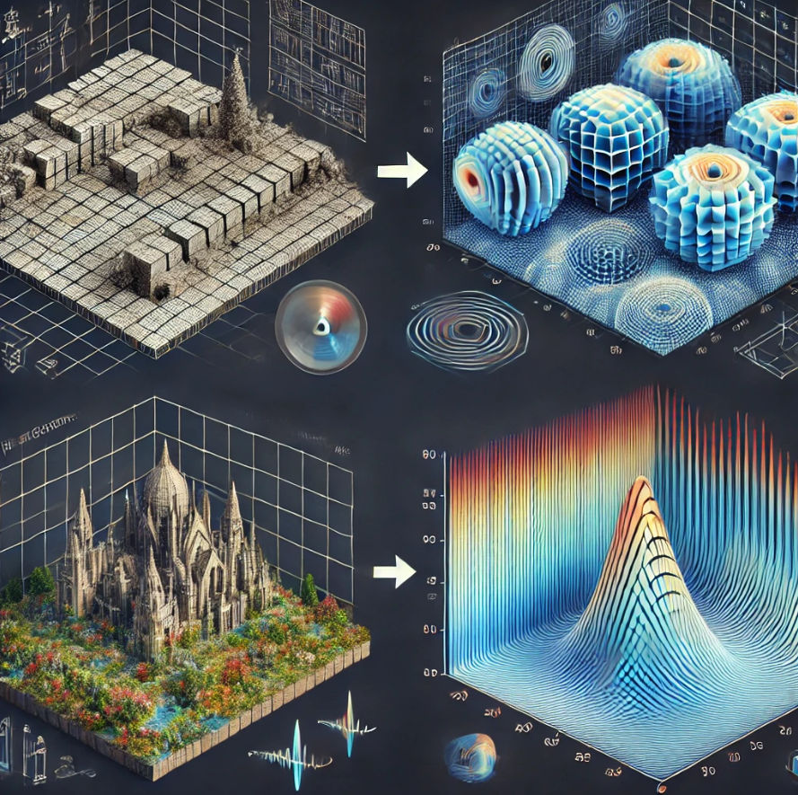
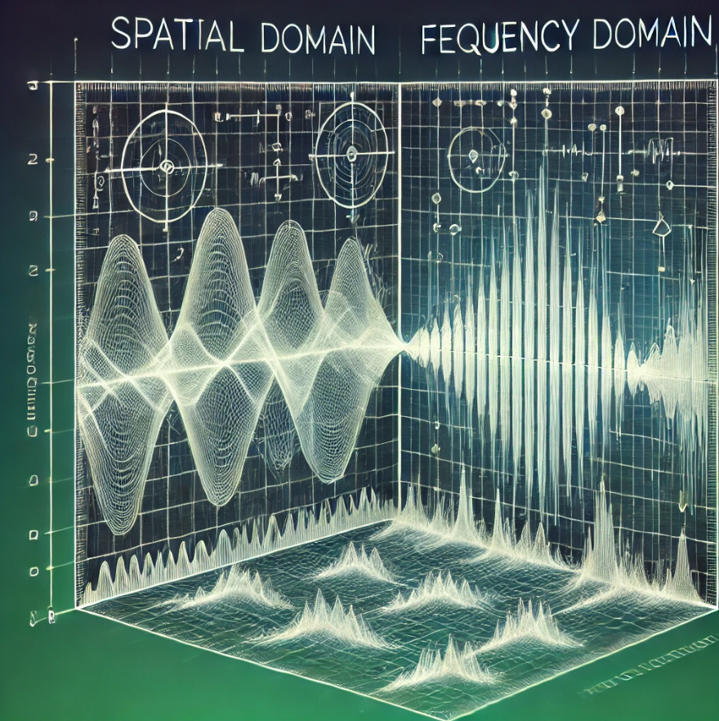
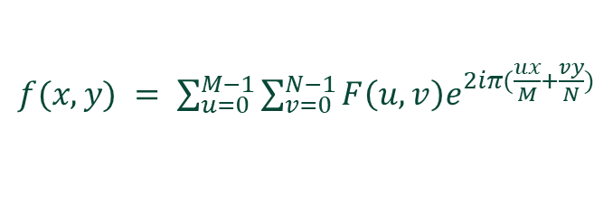
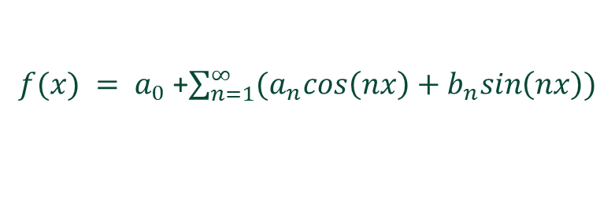
K. J. Somaiya School of Engineering, Mumbai – 400 077
(A Constituent College of Somaiya Vidyavihar University) S.Y. B. Tech. Semester – III (2024-2025)
Integral Transform & Vector Calculus
IA-2
Application of Fourier series in image processing
Name : Shreyans Tatiya
Roll No : 16010123325
Div. : E2 Subject: ITVC IA2
Description
The Fourier series decomposes periodic signals into sums of sine and cosine functions. In image processing, it breaks images into frequency components for tasks like filtering, noise reduction, and compression. By transforming to the frequency domain, key features are preserved, while noise can be removed. This technique is widely used in JPEG compression and edge detection, enabling efficient image storage and processing.
Equations
Fourier Series Decomposition
$f(x) = a_{0}$ +$\sum_{n=1}^{∞}{(a_{n}cos\left(nx\right)+b_{n}sin\left(nx\right))}$
Inverse Fourier Transform (2D)
$f(x,y) = \sum_{u=0}^{M−1}{\sum_{v=0}^{N−1}{F\left(u,v\right)e^{2iπ(\frac{ux}{M}+\frac{vy}{N})}}}$

Slide 2

Fourier series in image processing Dynamics
Fourier series in image processing Limitations
Limitation | Description
Non-periodic Signals | Fourier series struggles with non-periodic signals or finite images.
Edge Discontinuities | Gibbs phenomenon causes overshoot near sharp edges in images.
High Computational Cost | Transforming large images can be computationally expensive.
Limited Localization | Lacks spatial localization, making it hard to detect localized features.
Frequency Domain Artifacts | Can introduce artifacts when filtering or compressing images.
Difficulty with Colour Images | Processing RGB channels independently can lead to mismatches in quality.
Aspect | Description
Decomposition | Breaks down an image into sine and cosine frequency components.
Frequency Domain | Transforms spatial data into frequency data for analysis.
Noise Reduction | Filters out high-frequency noise while preserving image quality.
Image Compression | Reduces image size by discarding less significant frequencies.
Edge Detection | Highlights edges by focusing on high-frequency components.
Conclusion
The Fourier series is a powerful tool for breaking down complex signals into frequency components.
It plays a key role in noise reduction, filtering, and image compression.
This method enhances the ability to process and manipulate images effectively.
Despite its limitations, it remains foundational in frequency-based image analysis.
Fourier series continues to drive advancements in digital signal and image processing fields.
The Fourier series allows efficient transformation between the spatial and frequency domains for image analysis.
It provides critical insights into patterns and textures within images, improving various image processing tasks.
With the interplay of frequencies and signals, Fourier series orchestrates a seamless transformation, revealing the hidden patterns that define the essence of image processing.
References
https://www.sciencedirect.com/topics/engineering/fourier-transform
https://homepages.inf.ed.ac.uk/rbf/HIPR2/fourier.htm

